Slide 1

Application “Easy Learn”
Developed by Group1
Mengru.JI
JunQI.Sun

Slide 2
Content
Introduction
Detail of Application
Login and SignUp Activity
Main Activity
Daily Attendance
Mission Activity
Mission Result Activity
Wrong Mode Activity
Question Book Activity
Timer Activity
Achievement Activity
Summary

Slide 3
1 Introduction
1.1 Our Motivation
Lack of passion to learn German
Want to have a customized learning application that more suitable for our own needs
Use it to repeatedly practice German exercises that collected by ourselves

Slide 4
1 Introduction
1.2 Overview
Main part of this app:
Have your own account (Learning progress, points, personal Wrong Question Book and Favorites, daily attendance record and so on)
Consolidate grammar and vocabularies in the form of single-choice questions
Have Fun with your friends (Learn German together in the form of competitions)
Simple Pomodoro (Actually just implemented by a Countdown)

Slide 5
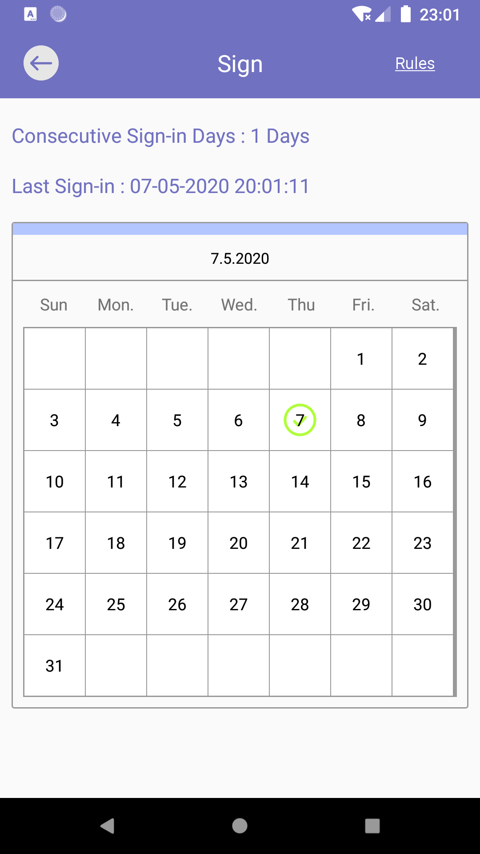
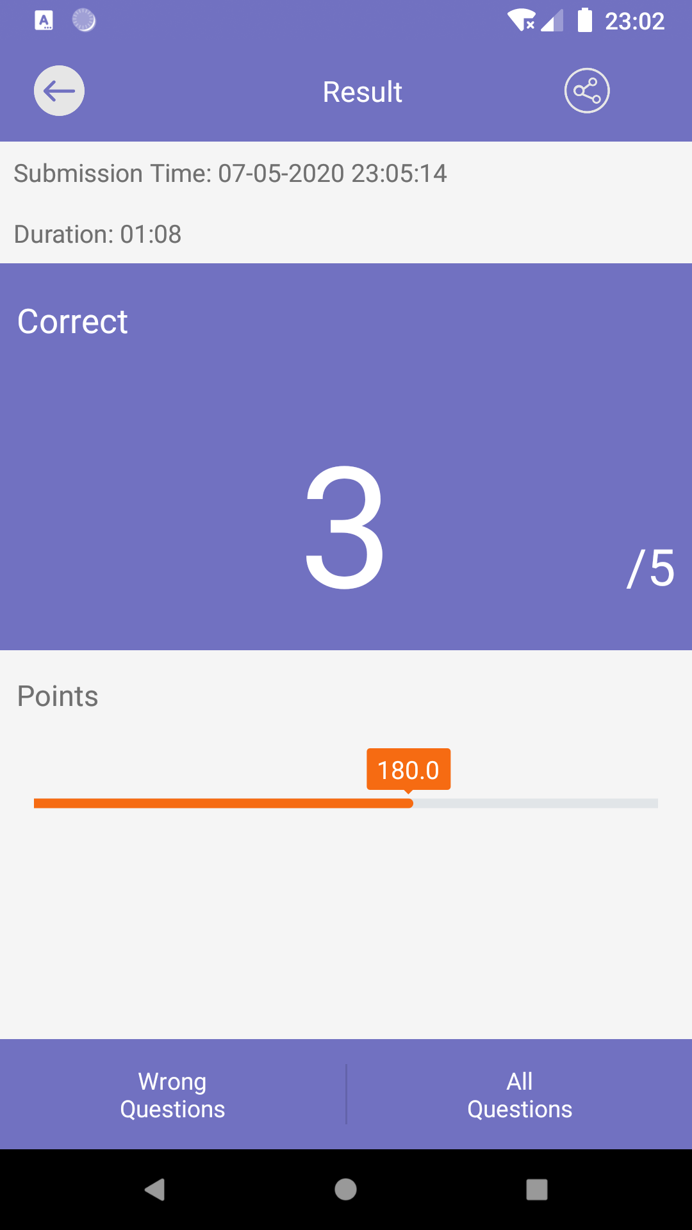
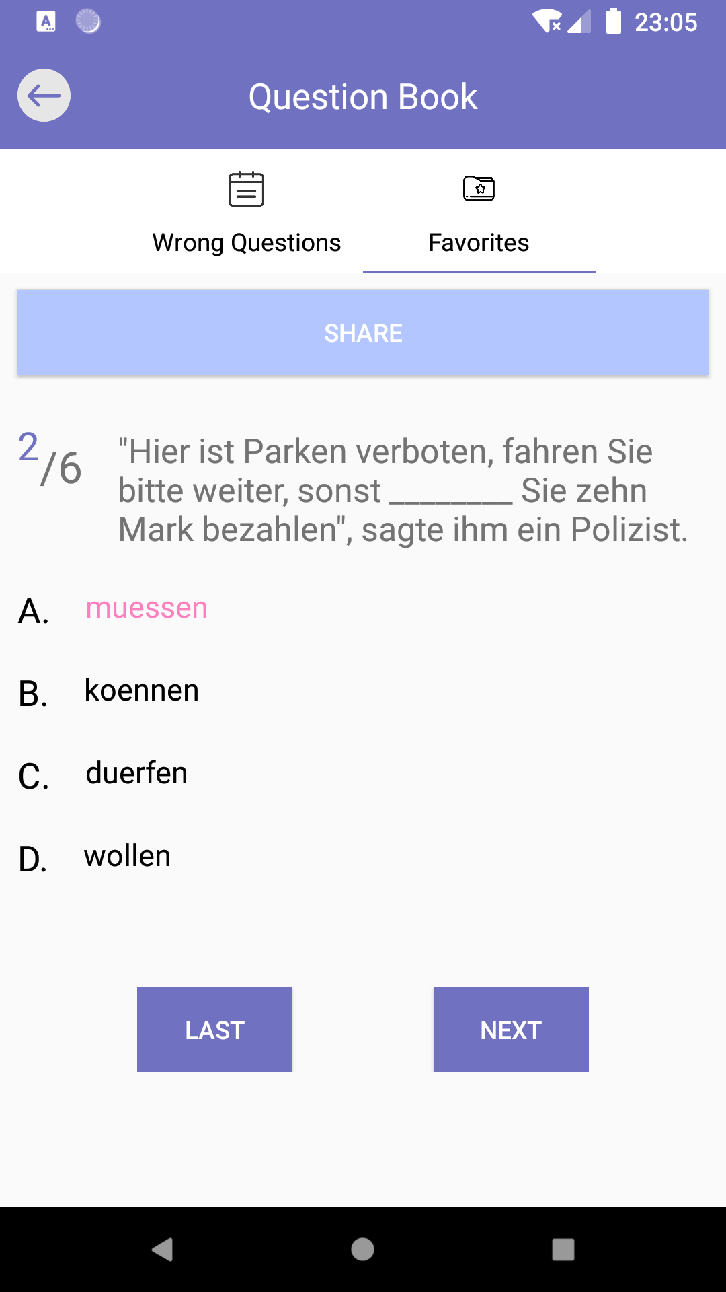
2 Detail of Application
2.1 Function Specification
Local Room Database, SQLite
Customized UI components with Animation
Multiple Activities
Layout, Fragments, View Pager…

Slide 6
2 Detail Of Application
2.2 Main Classes of Application
Signup Activity
Login Activity
Main Activity(AlarmReceiver)
Check in Activity(SpecialCalendar, SquareGridView, SquareRelativeLayout, CheckInAdapter)
Mission Activity(BackDialog,TimerDialog)
Mission Result Activity(MyProgressBar)
Wrong Mode Activity
Competition Start Activity
Competition Activity
Question Book Activity(TabPagerAdapter, PagerFragment)
Timer Activity
Achievement Activity
DatabaseCreator(User, UserDao)
MySQLite(Questions)

Slide 7
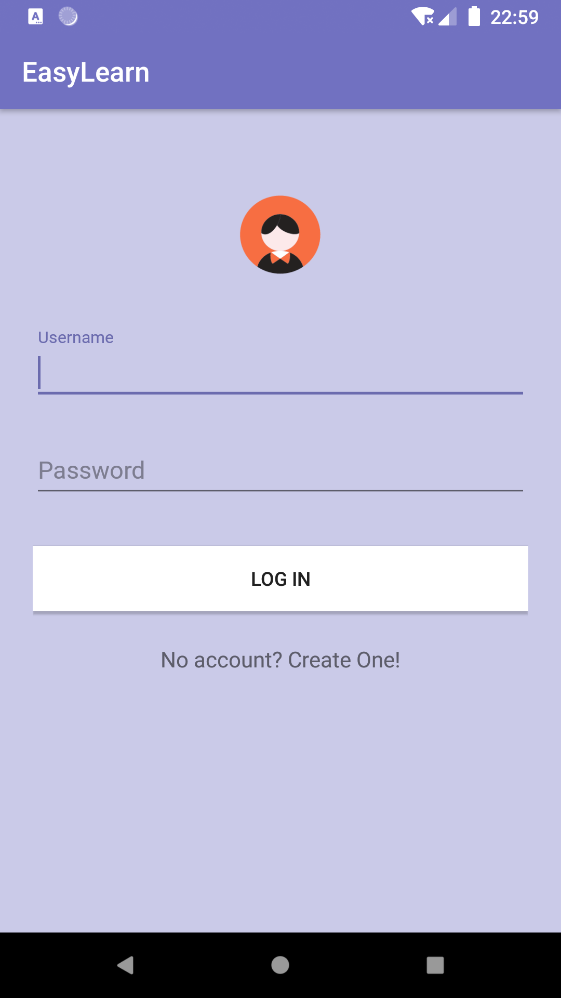
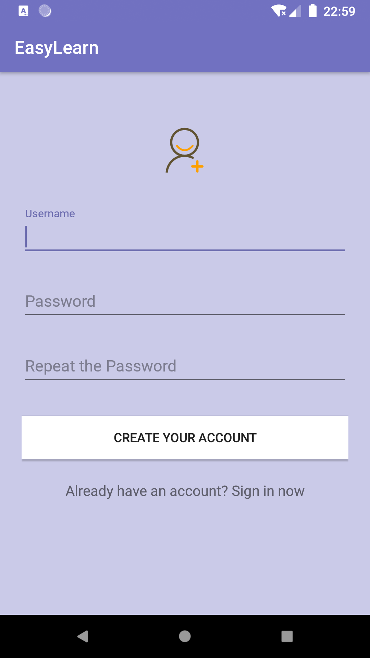
Login and Sign Up Activity
TextInputLayout with EditText
Check your Account and Jump to Main Menu
Check your Input and Create your Account
Jump to Register
Jump to Login

Slide 8
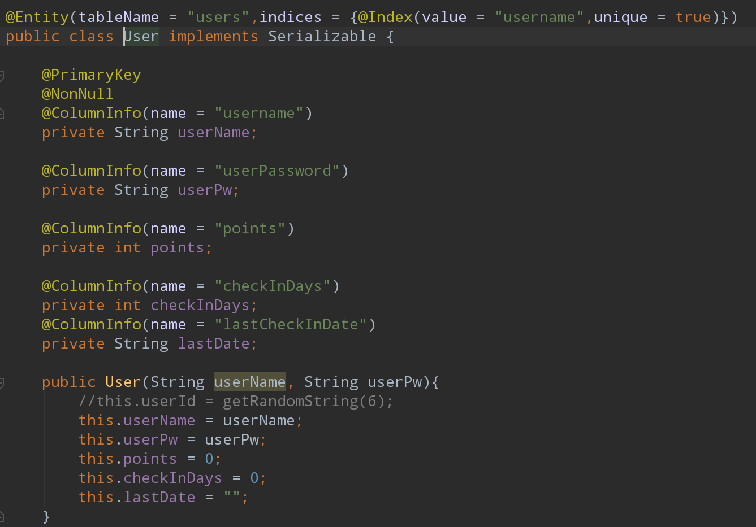
Login and Sign Up Activity
Data(stored in Local Room Database)
User Object:
username(primary key, must be unique)
points
password
continuous daily attendance days
last clock time

Slide 9
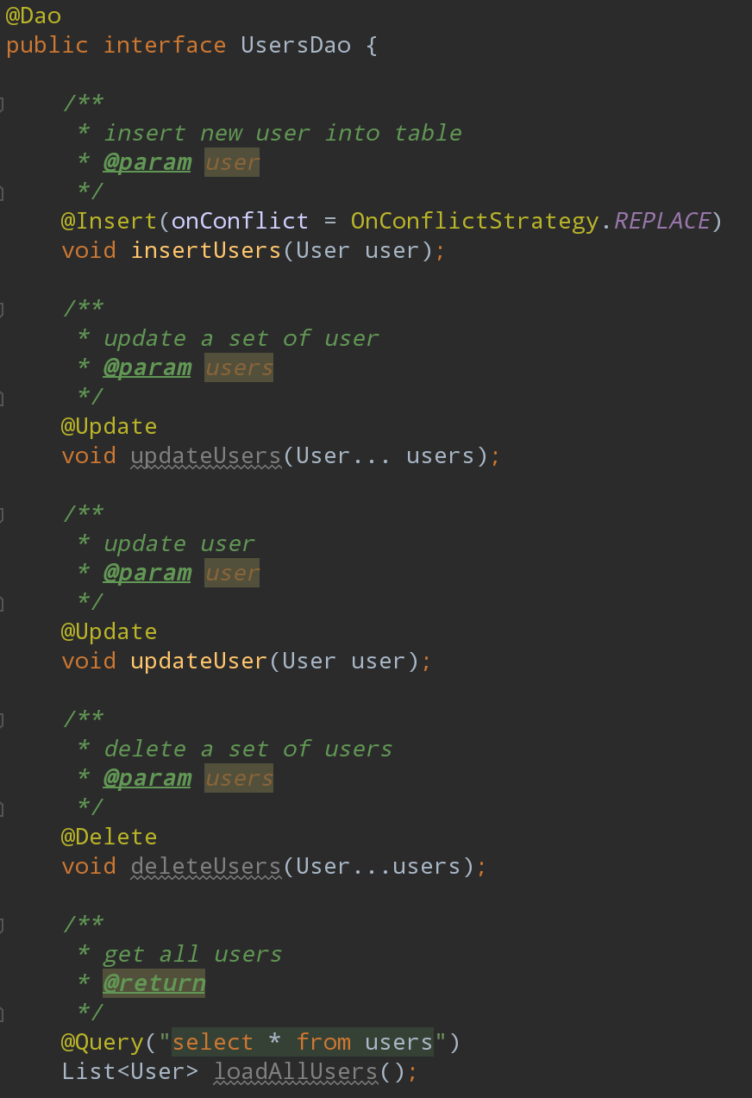
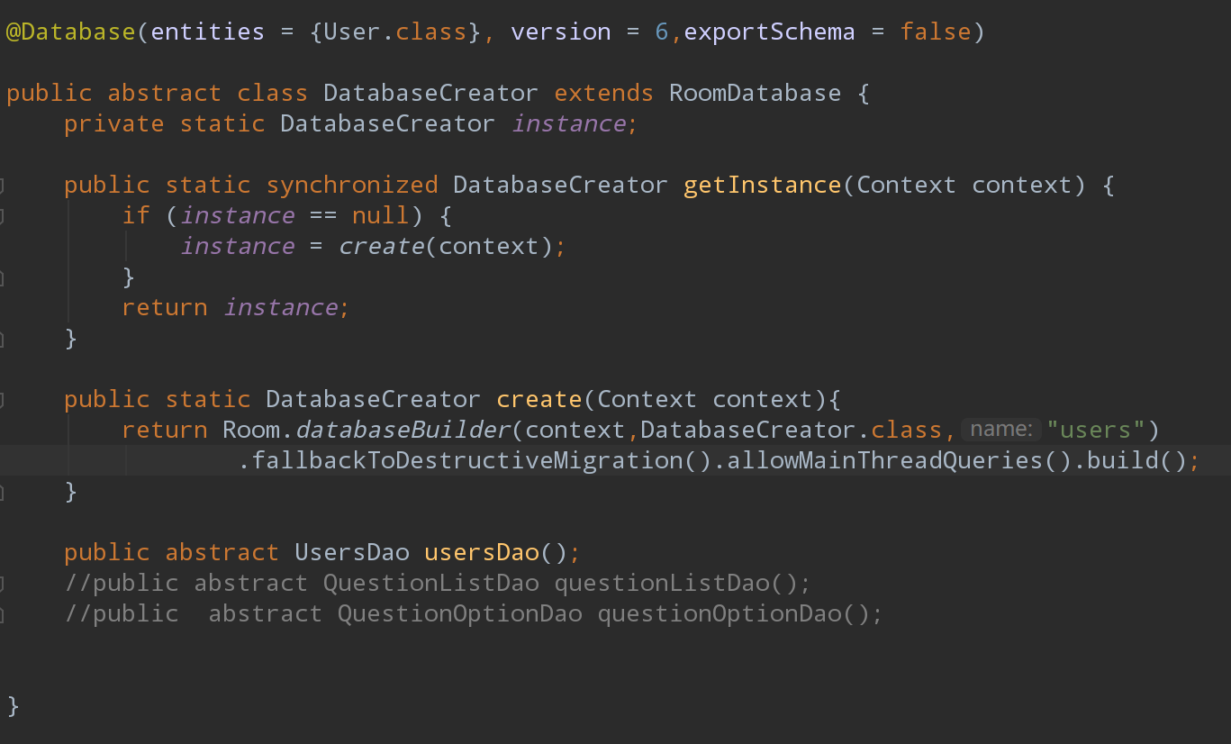
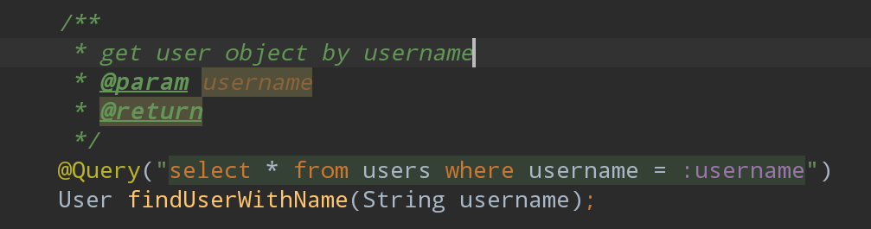

Slide 10
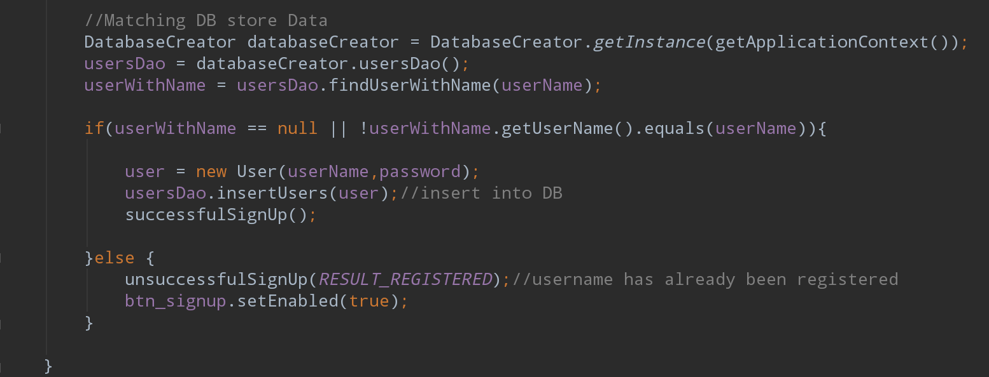
Save user data in database
Sign up Activity

Slide 11
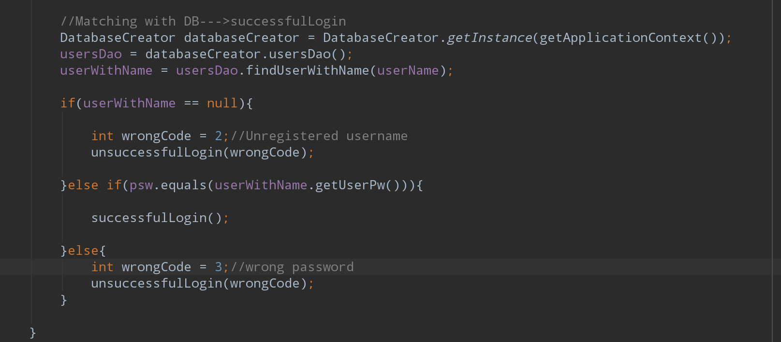
Get user data from database and compare with your input
(wrongCode = 1 means your input is incomplete)
Login Activity

Slide 12
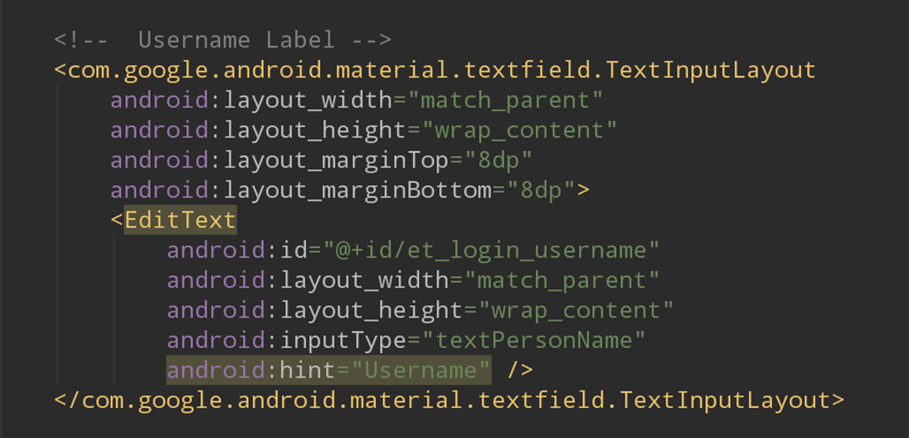
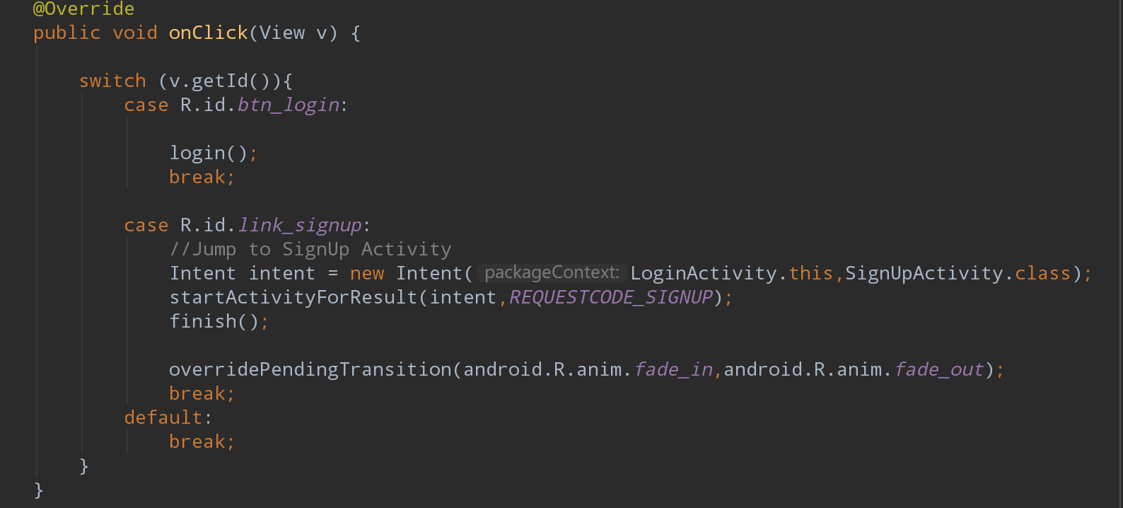
EditText in a TextInoutLayout to get your input
Set Click Listener on Button and TextView

Slide 13
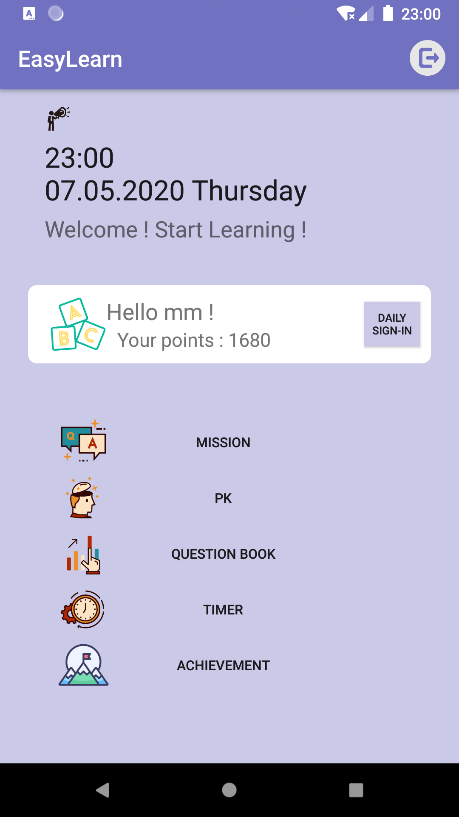
Main Activity
sign out(back to login activity)
current Time
Check your personal account information
Buttons: jump to different activities

Slide 14
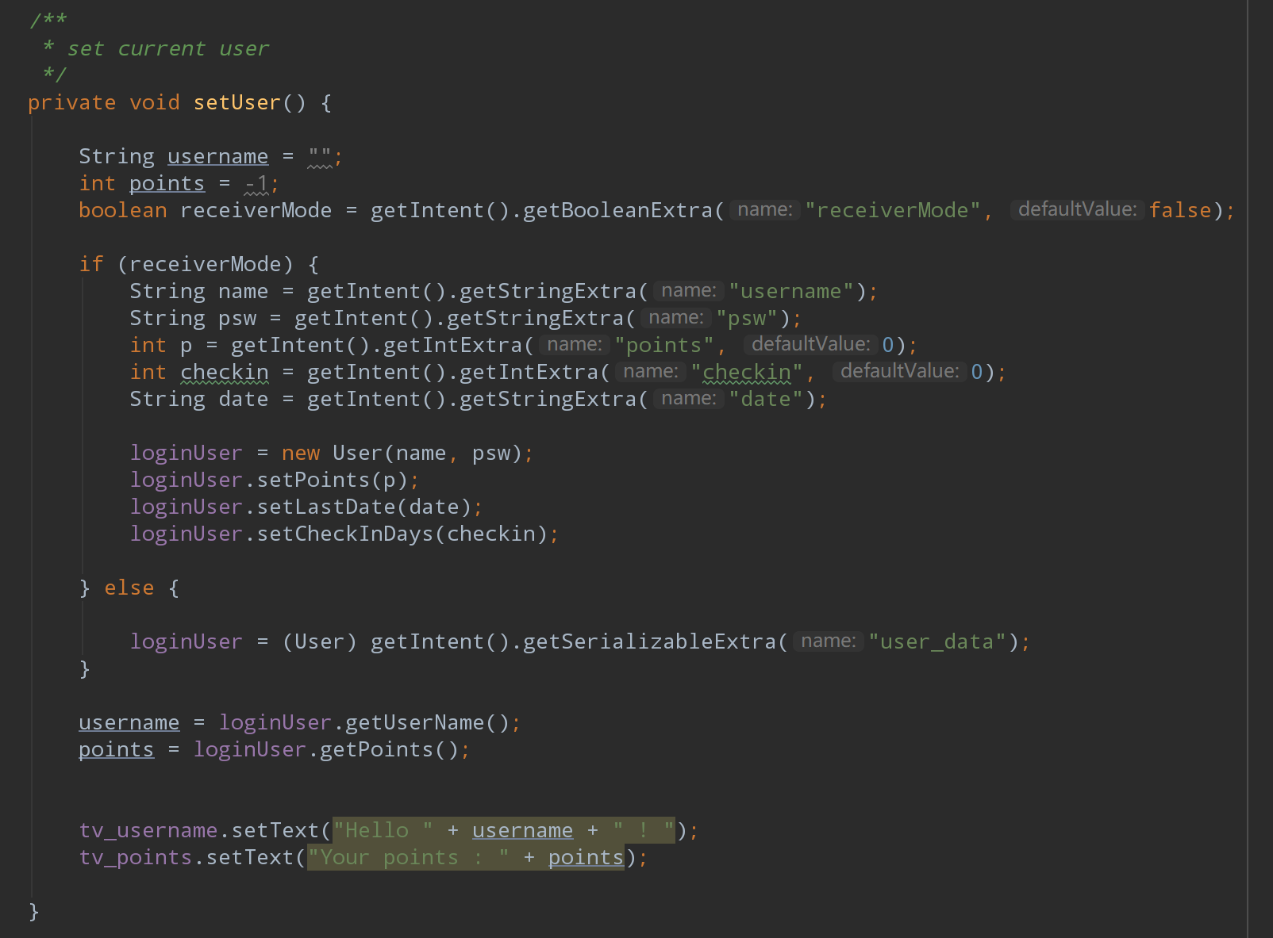
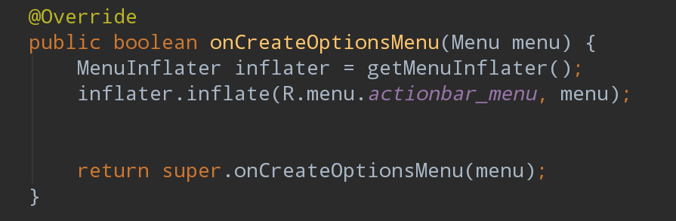
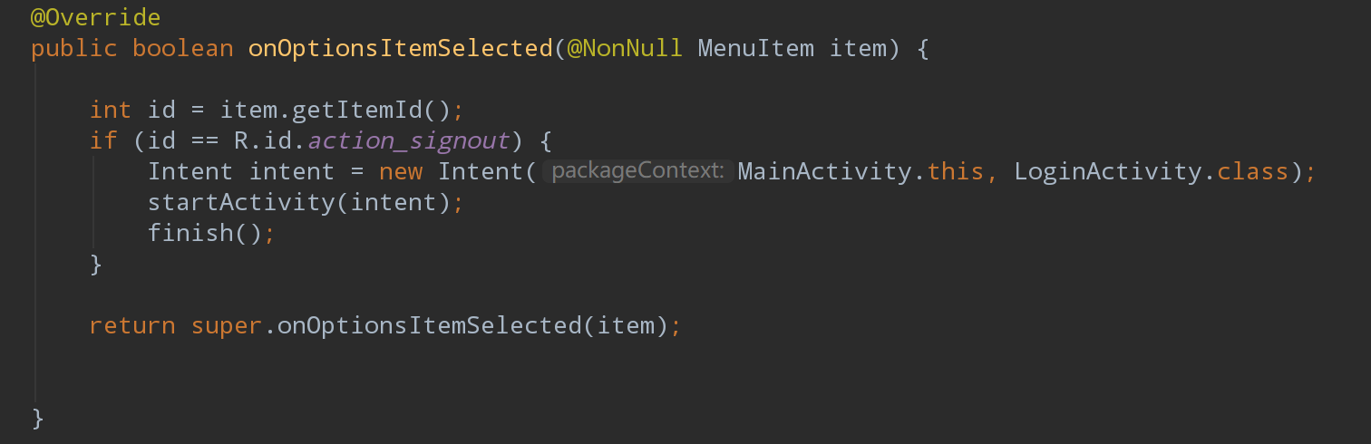
Get user data from intent
Set Action bar

Slide 15
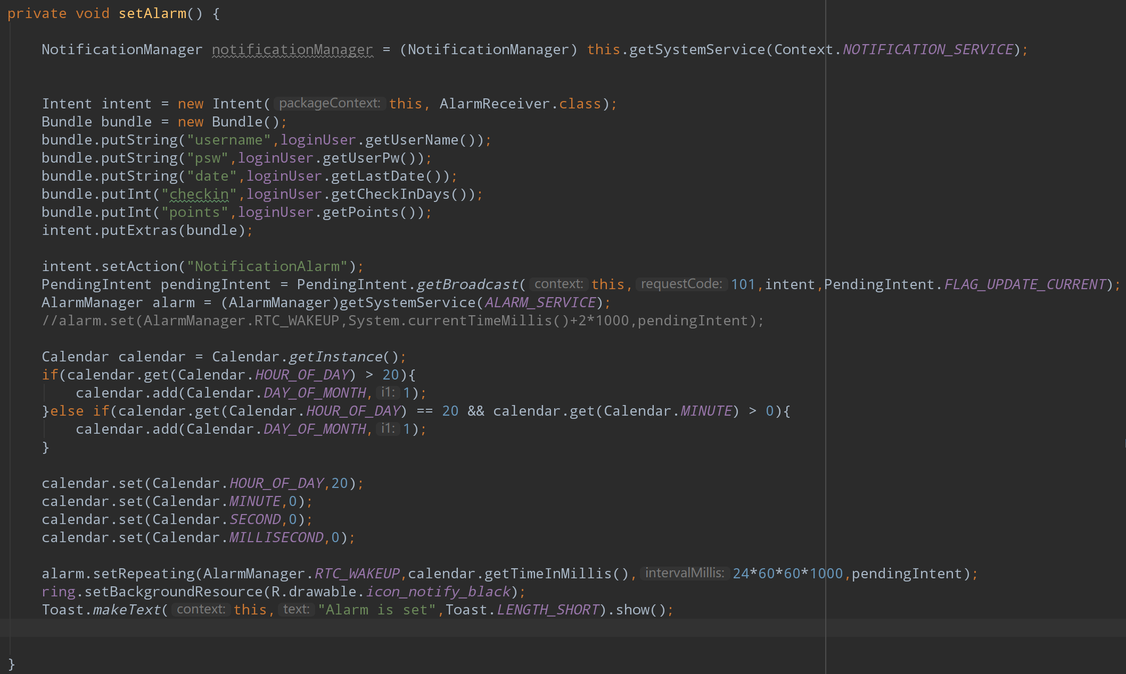
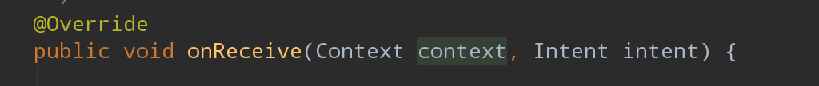
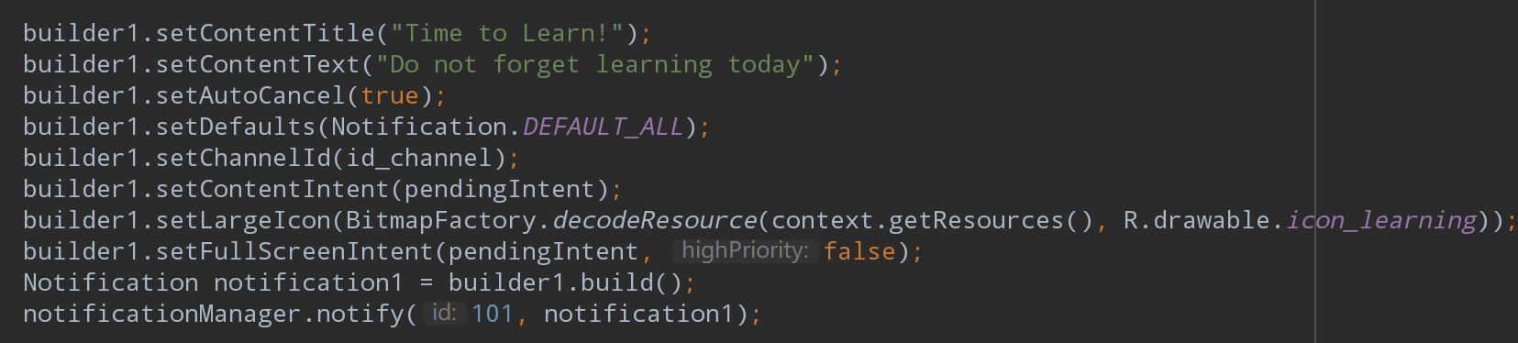
Set Alarm
Also implemented a class Alarm Receiver which extends Receiver
Must override method onReceive()

Slide 16
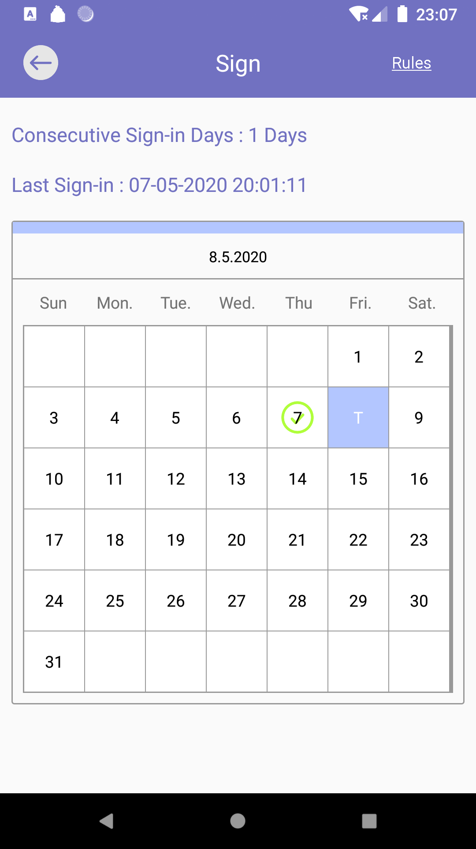
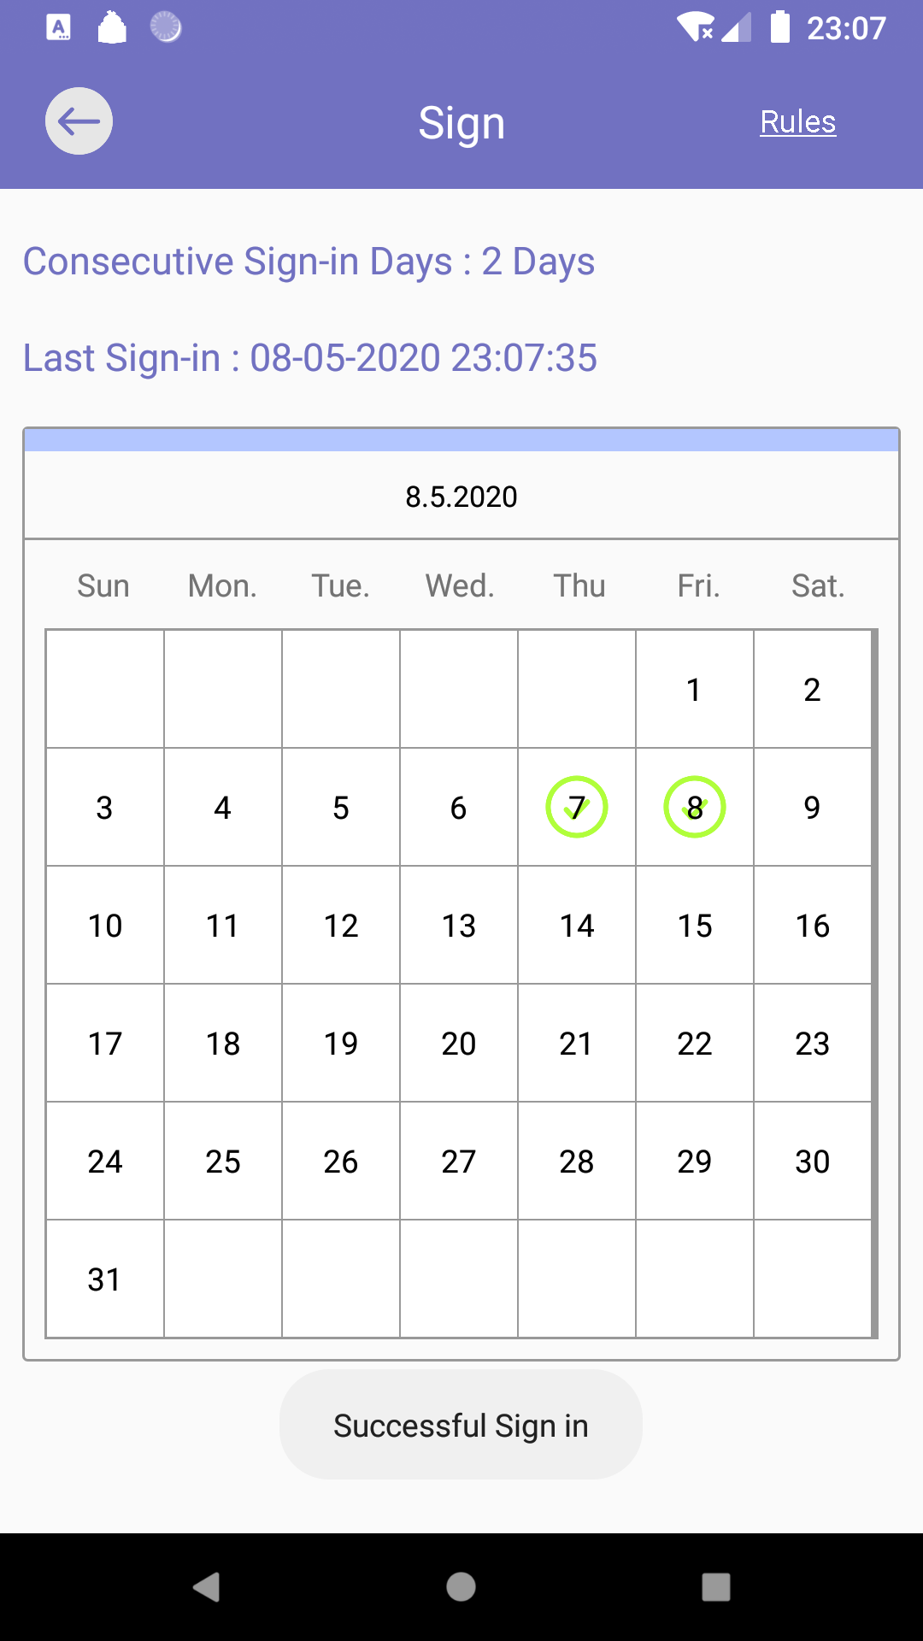
Daily Attendance
Back to Main Menu
Last time clocking info
Update info after clocking
today
Toast message
before
after

Slide 17
Class: Special Calendar
Create Calendar for this Activity

Slide 18
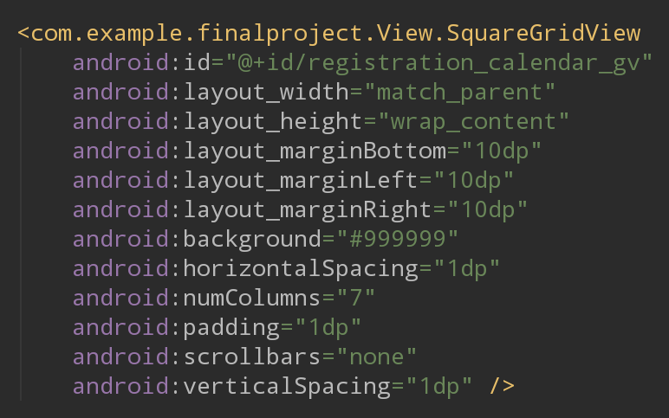
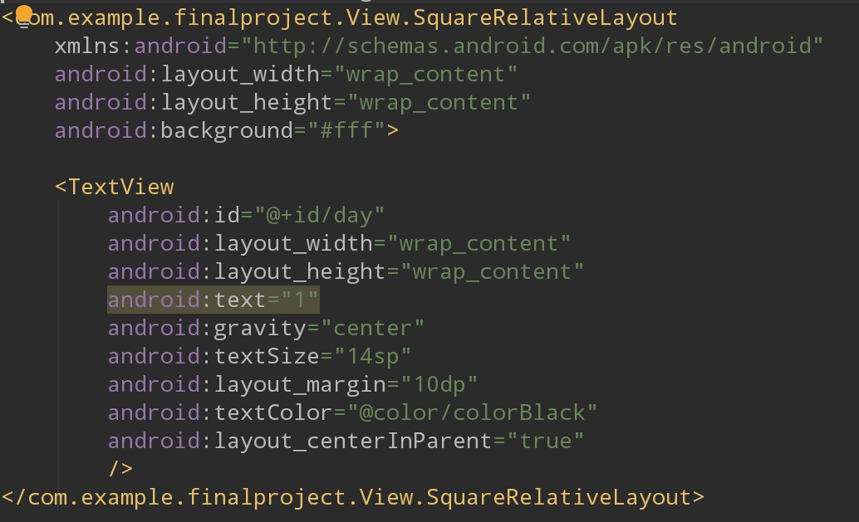
Class: Square Grid View(extends GridView)
Class: Square Relative Layout(extends RelativeLayout)
Class: CheckInAdapter(extends BaseAdapter)
Draw Calendar in this Activity

Slide 19
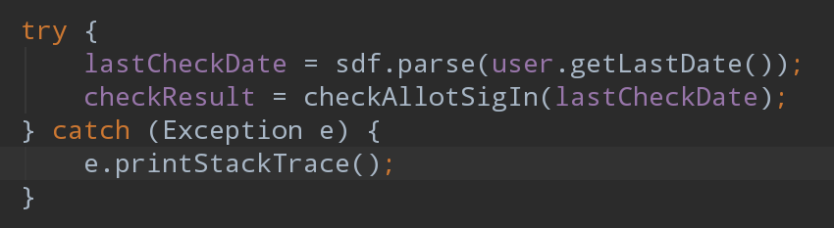
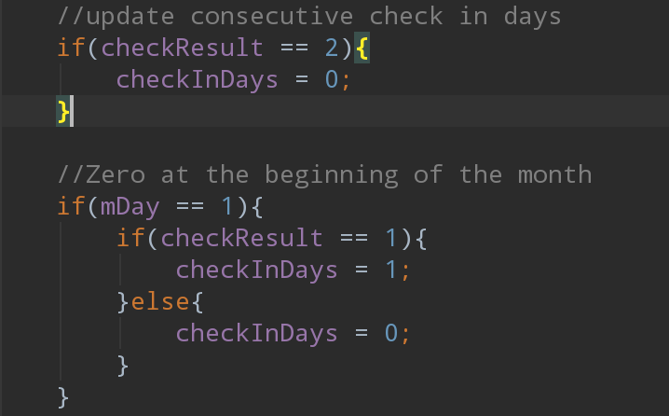
Get user last check-in Date
Compare this date with today and yesterday
Call method checkAllotSigIn(lastCheckDate)
Return 1: already checked in today
Return 0: in continuous check-in state
but have not checked-in today yet
Return 2: number of continuous check-in days is 0(last check-in time is before the day before yesterday) and have not checked- in today
Update continuous check-in days of user object according to “check result”
Set Adapter and onItemClickListener

Slide 20
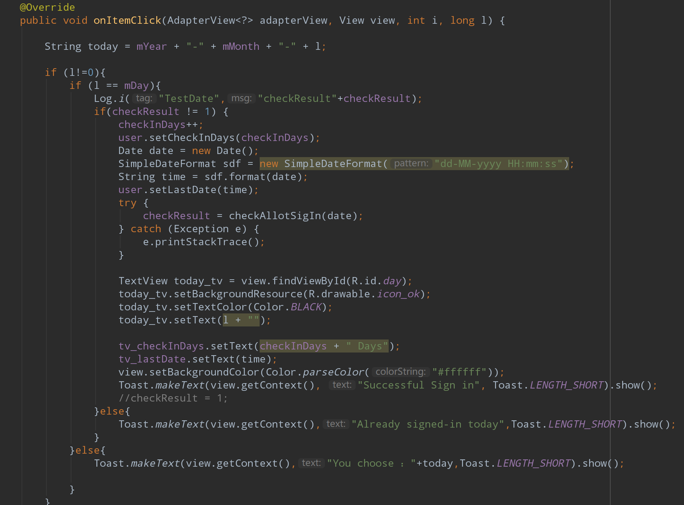
Click on any grid on the calendar
Then whether the current grid shows today will be determined
If it’s today, then will check if you have signed-in today or not(according to checkResult)
Update user’s continuous check-in days and last check-in date
Messages will be toasted

Slide 21
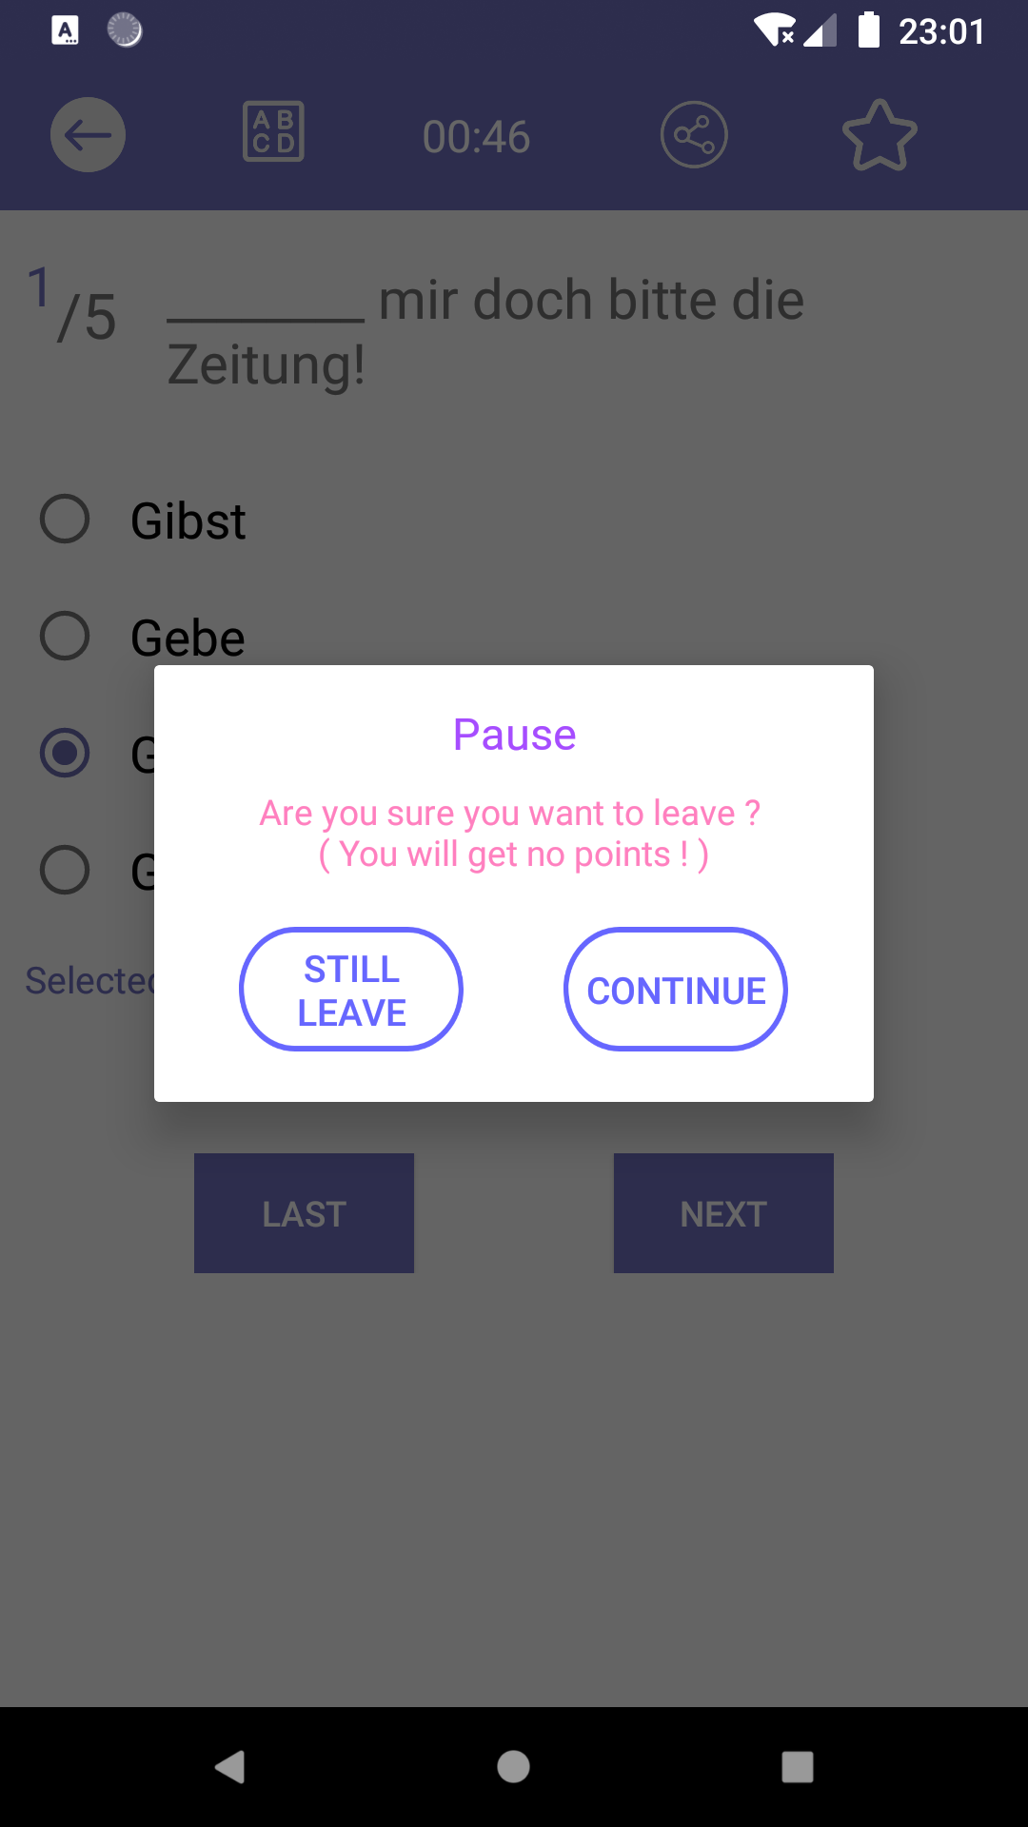
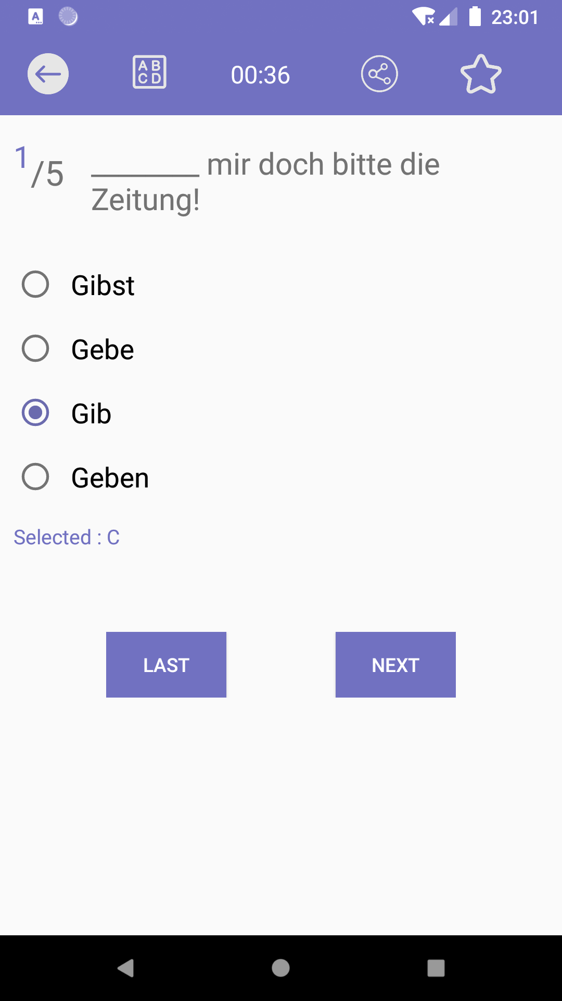
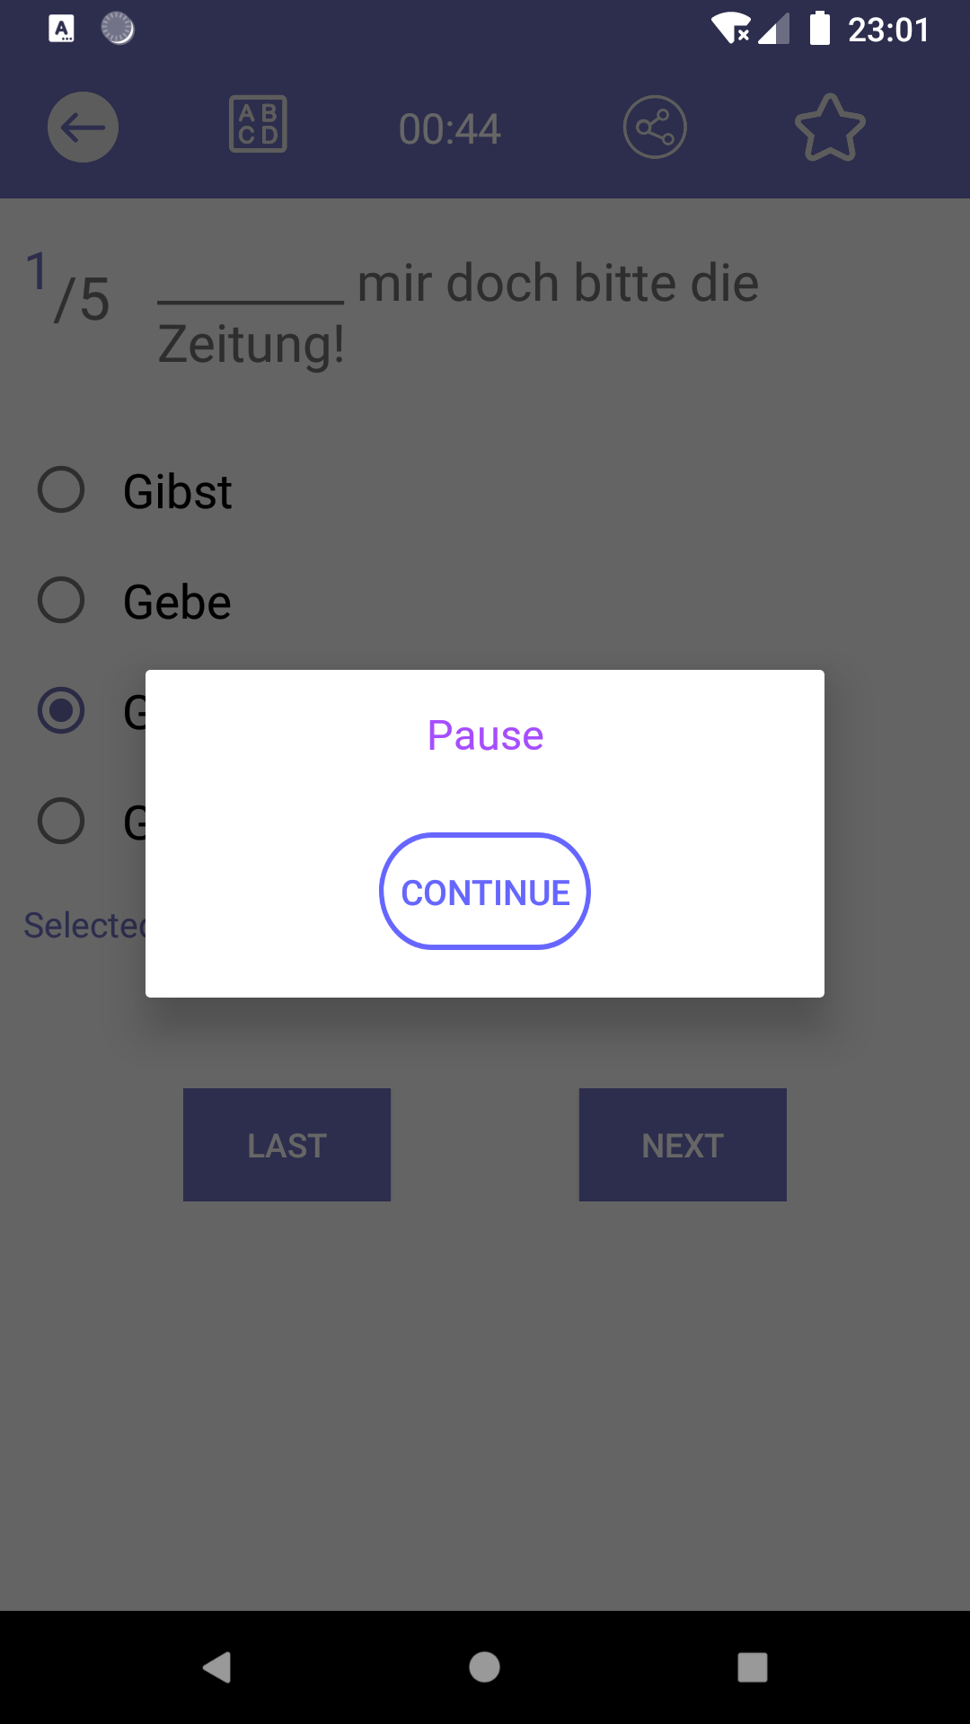
Mission Activity
back
timer
share
Add / remove
favorites
Detail of current question
Previous que
Next que

Slide 22
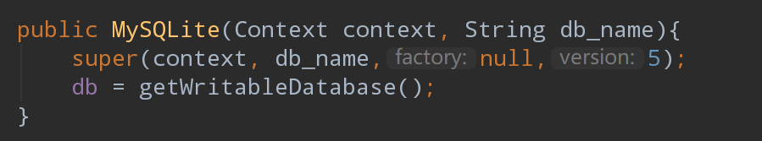
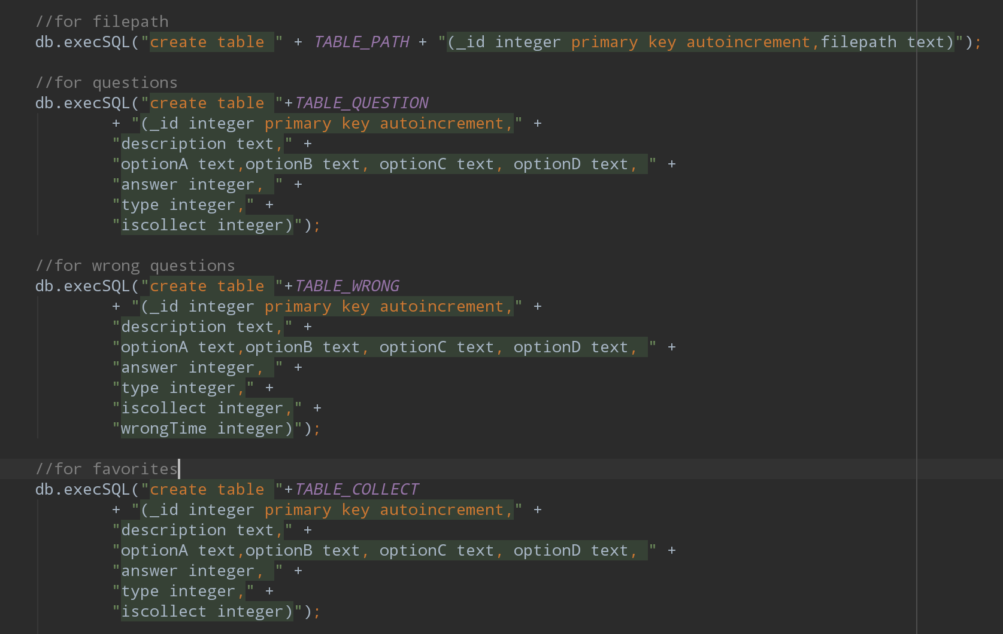
Where do I save all the questions?
--------------- MySQLite(extends SQLiteOpenHelper)
Each user have their own database, so that they can have their own wrong question book and Favorites
Each database contains four tables, one for file path(name of file which includes some exercises), one for questions which includes all questions that you have inserted, one for wrong questions and one for favorites.

Slide 23
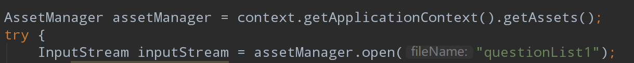
Important Methods in Class MySQLite
Use ContentValue to insert data into table
(should check if already inserted or not)
Use Cursor to traverse the entire table and get all questions in this table
Use Assetmanager and BufferedReader to read Questions which organized in the File

Slide 24
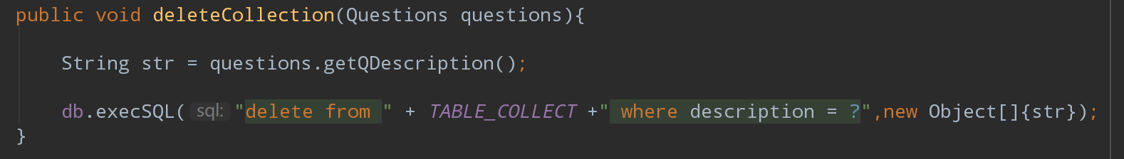
And also delete and update methods for tables in the database

Slide 25
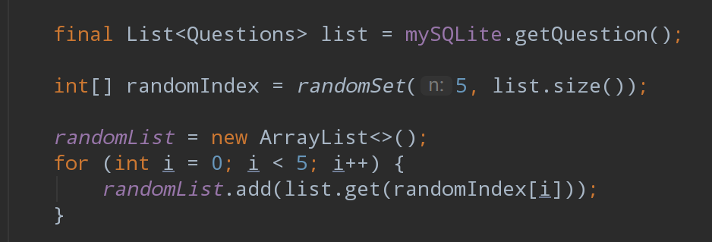
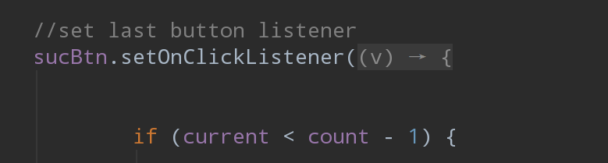
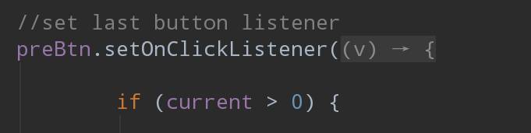
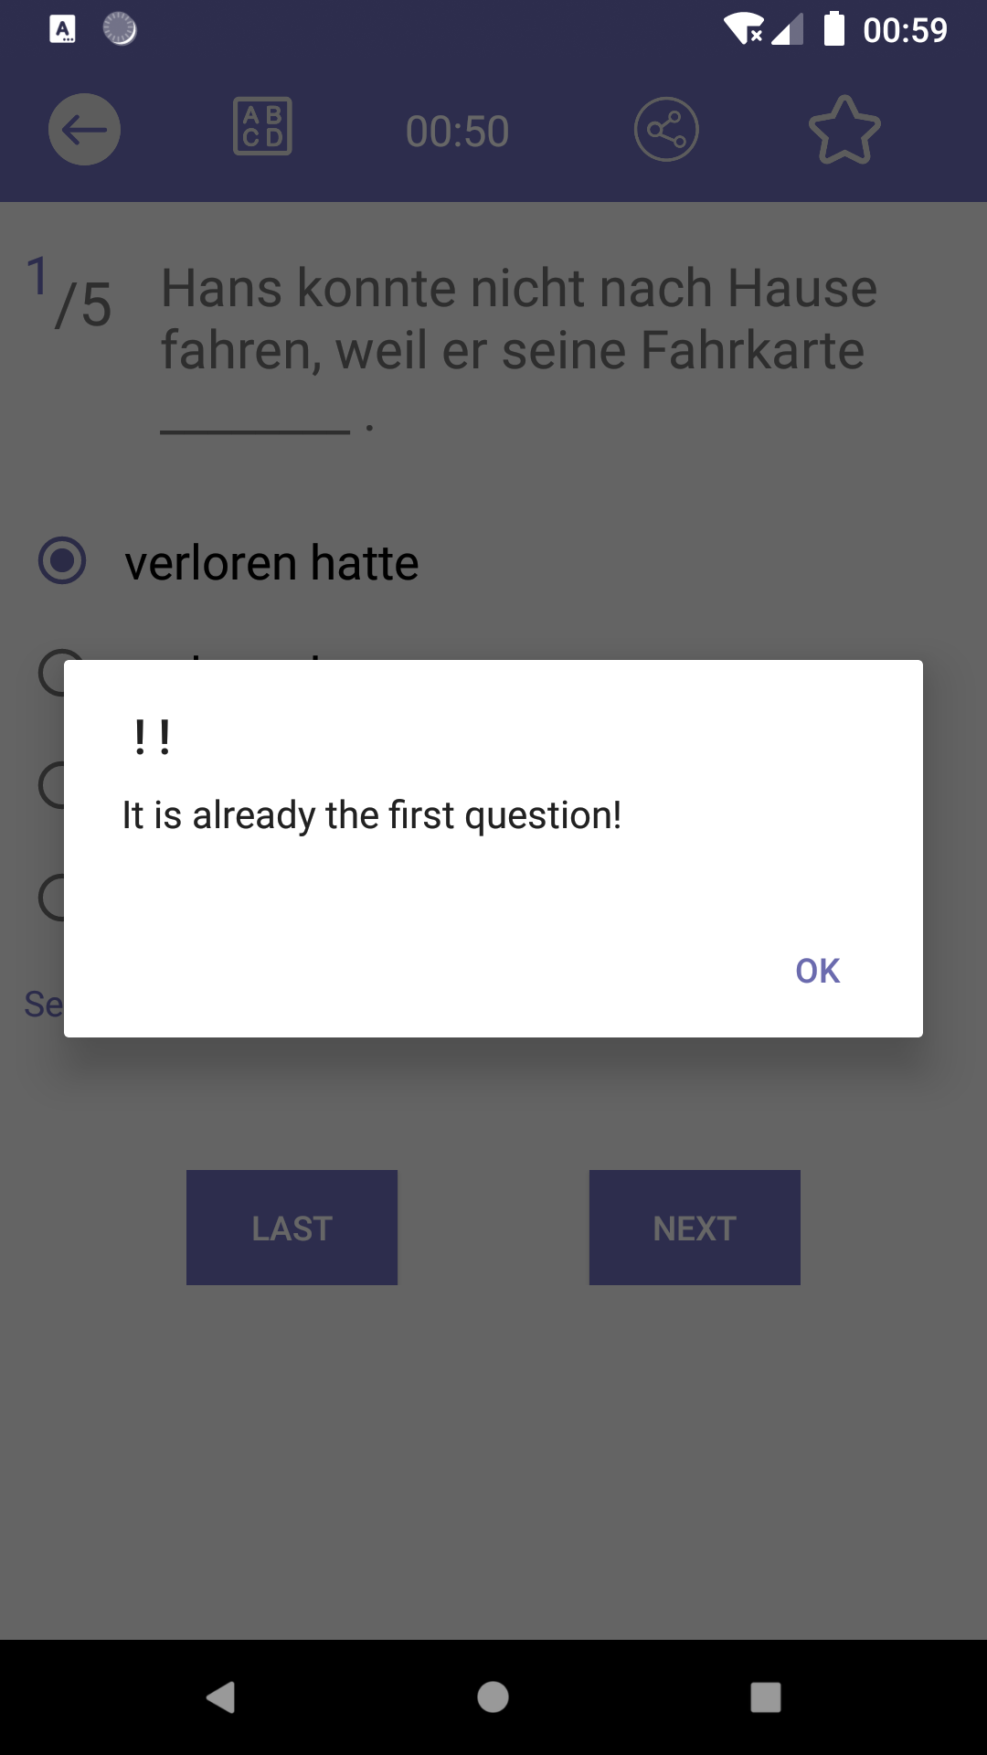
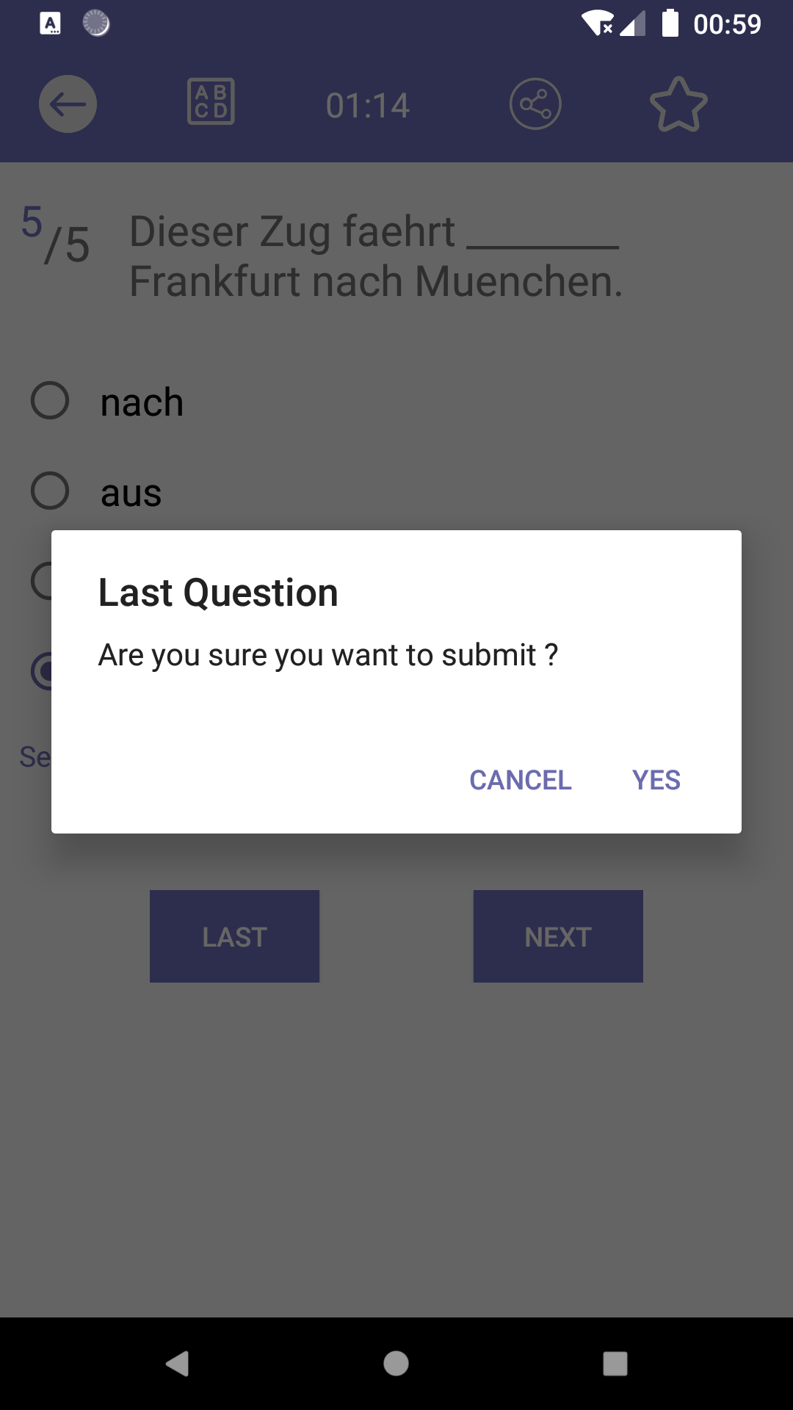
Randomly get 5 Questions from Database(get a int array with 5 random number between 0 and the size of all question list as index)
Global variables “current” : to mark the current position of the random question list
Check if it’s the first or last question of the list and set selected answer for each question every time the last/next button is clicked
Jump to MissionResultActivity after user submit the quiz

Slide 26
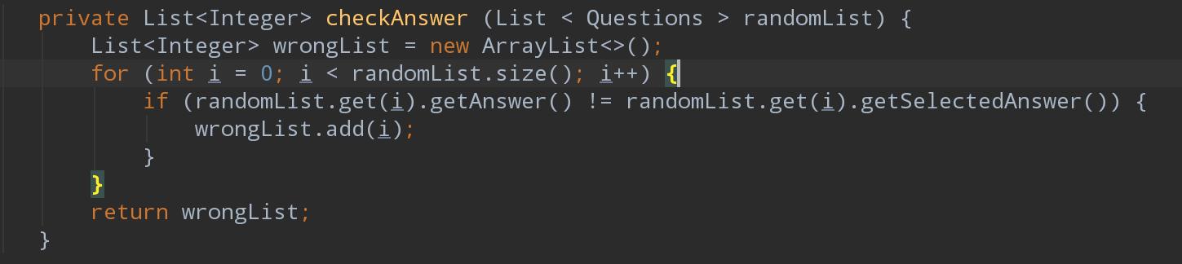
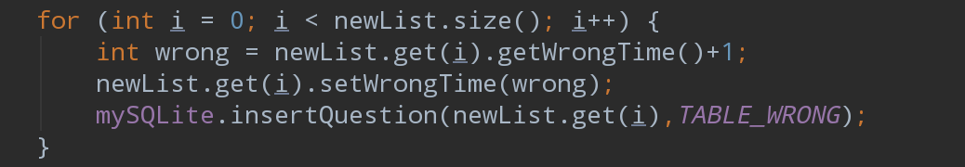
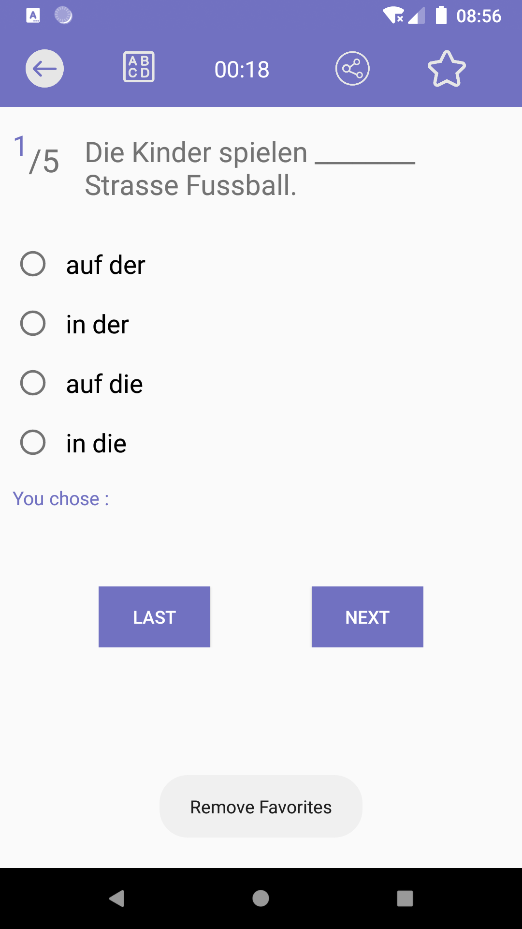
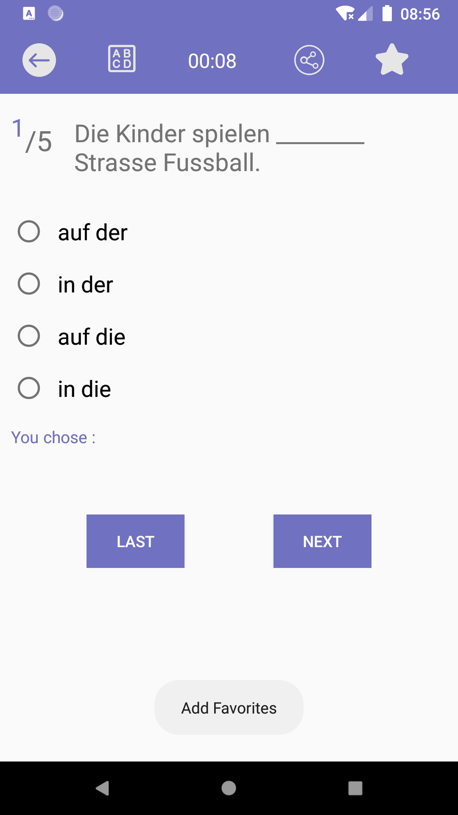
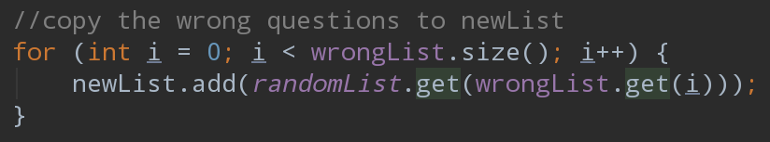
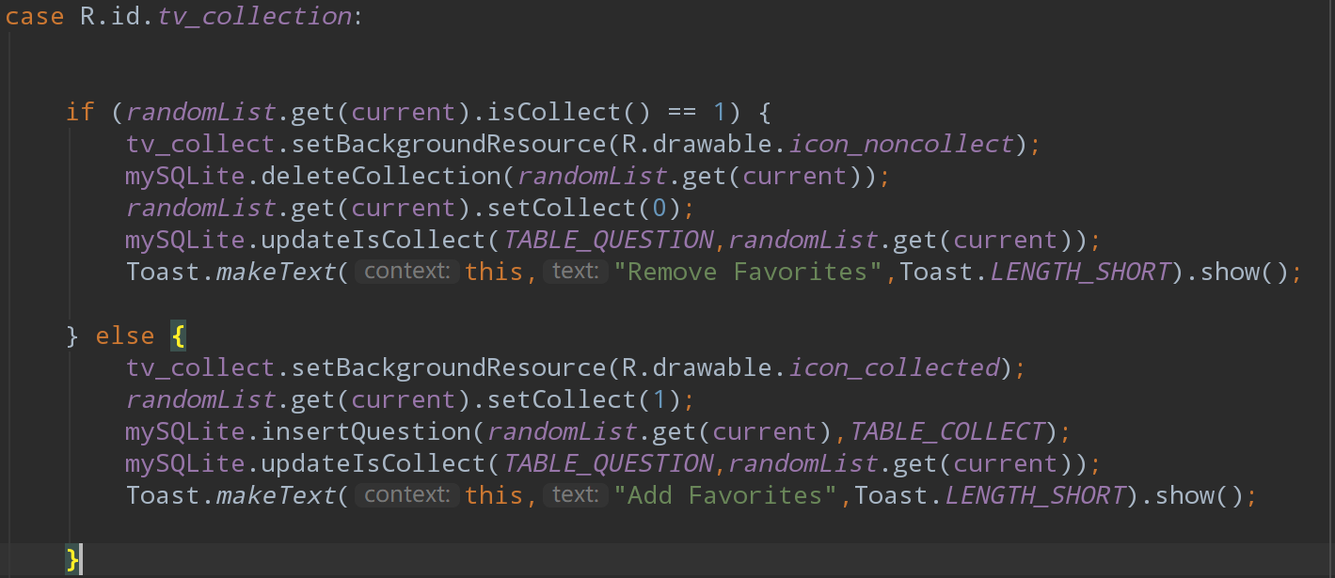
Check Answer after submission
Insert wrong Question into Database
Add/Remove current question from Favorites by clicking “Star”

Slide 27
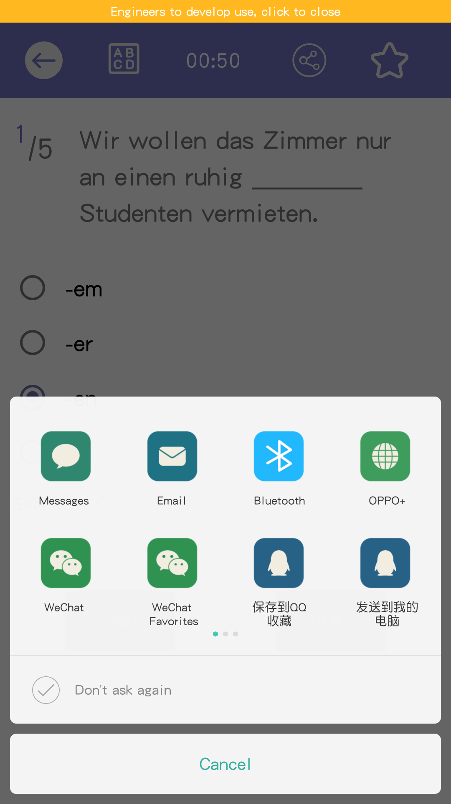
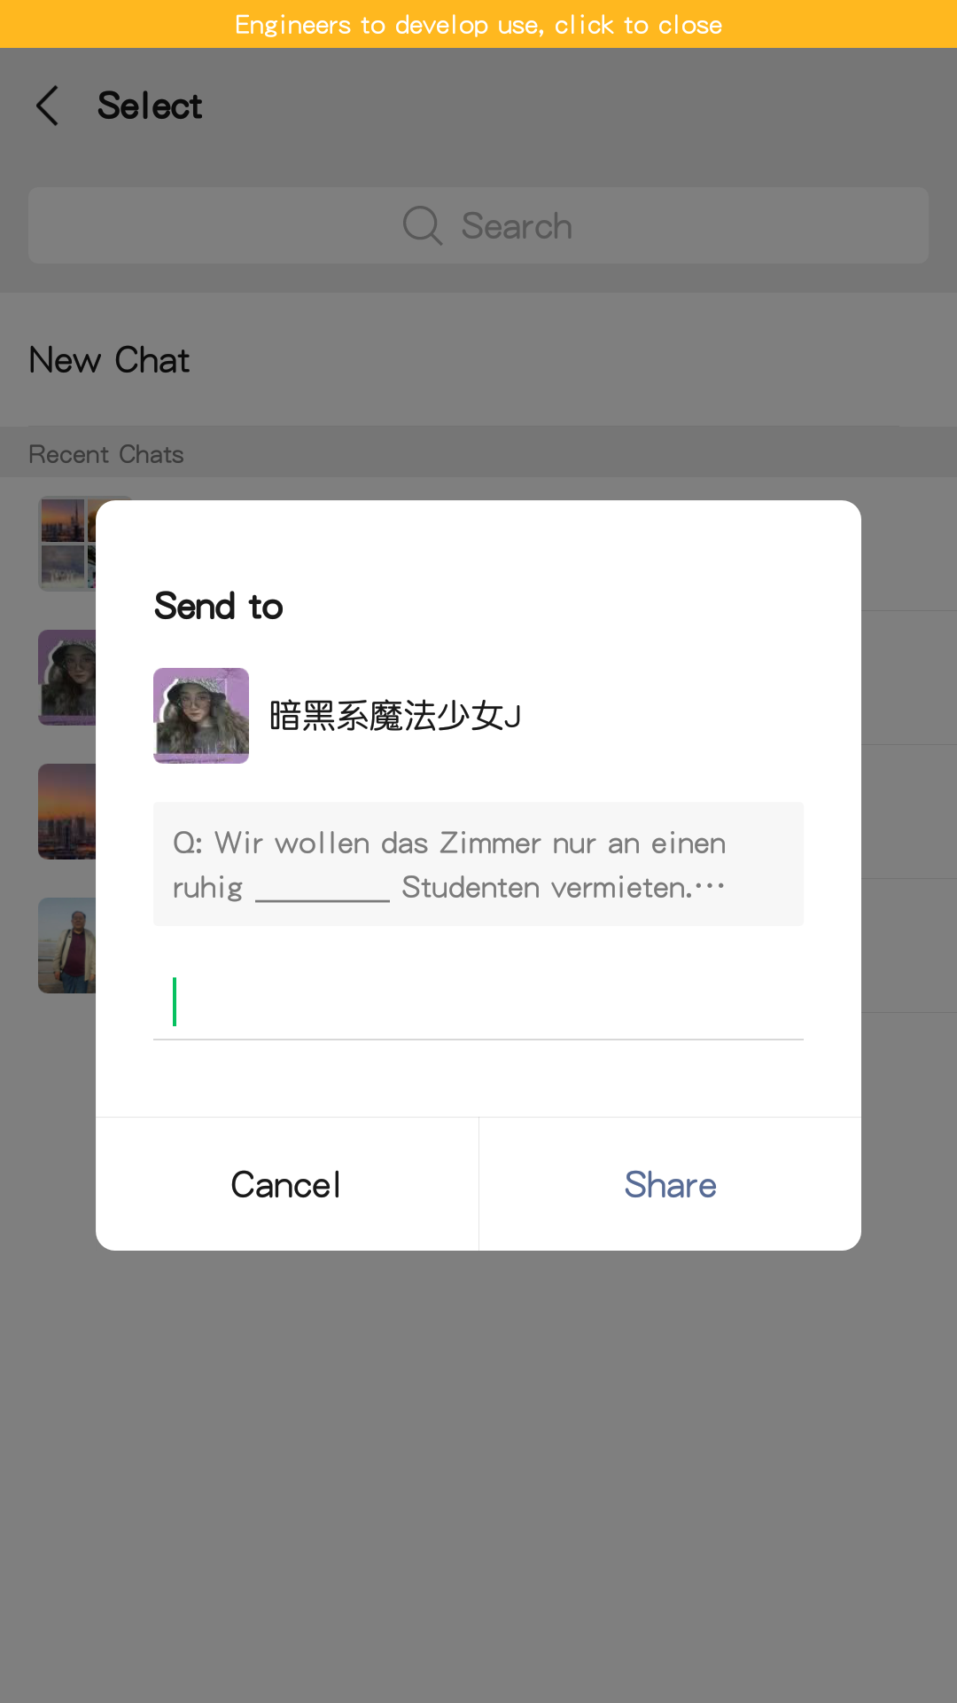
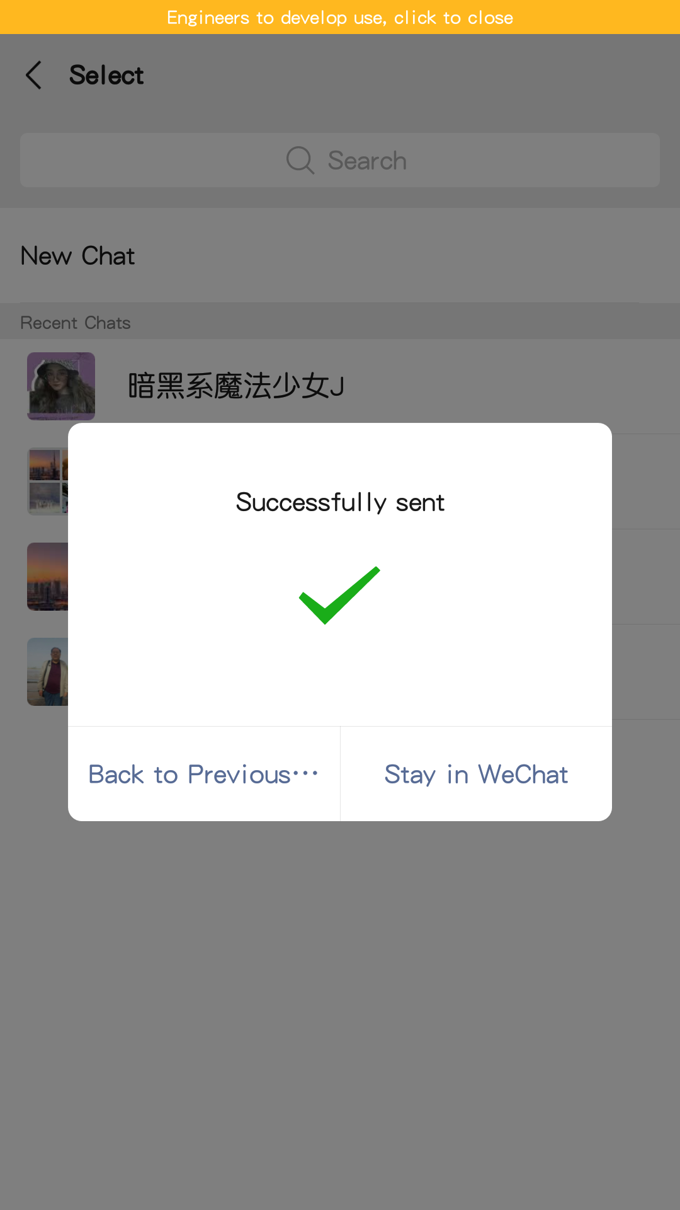
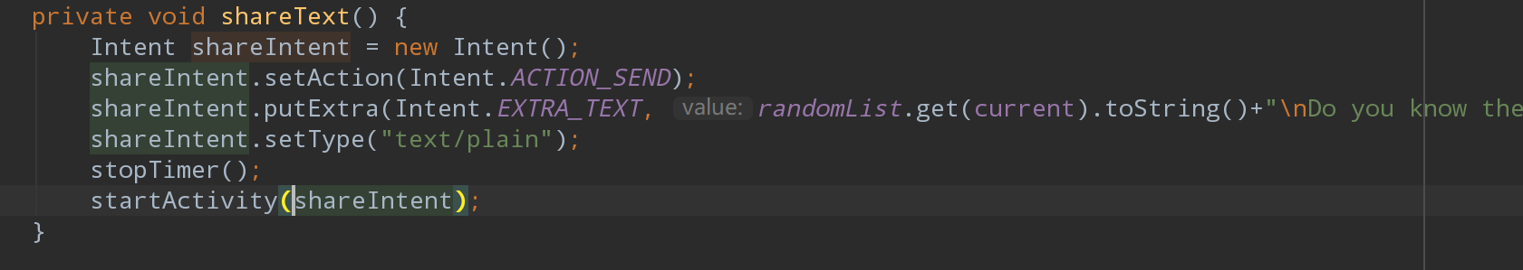
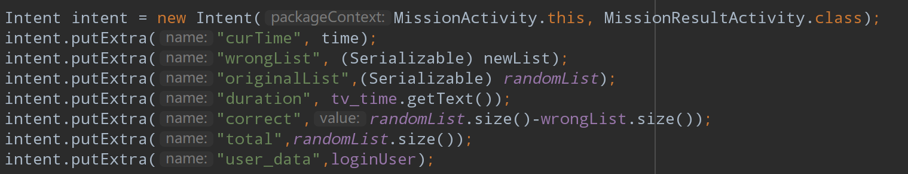
Mission Activity
Share current question in form of text
Send user object/ wrong question list/ random question list/ number of correct questions/ size of random questions list/duration of the quiz(text of timer)/submission time to next Activity via Intent

Slide 28
Mission Result Activity
Back to Main Menu
Share your points in form of text
Duration and Submission Time
Number of correct Questions
Points = correct rate * 300
Jump to Wrong Mode Activity to check all wrong questions this time
Jump to Wrong Mode Activity to check all questions this time

Slide 29


Calculate points of User and update User’s Data saved in the Room Database
Initialize progress bar to show points with animation

Slide 30

Tip View
Class: MyProgressBar
Because we customize the view, all the elements we see are drawn by onDraw().
First draw the bottom progress bar (the background color), and then draw the actual Progress.
tipHeight +
ProgressMarginTop
Actual Progress
Bottom Background

Slide 31




Use ValueAnimation to create Animation for our Progress Bar
Convert percentage to actual width(value/300 * mwidth)
Determine the distance the tip box moves
Points = percentage * 300

Slide 32


Wrong Mode Activity
All Questions List
Toolbar
(similar with Mission Activity)
Wrong Questions List
Mark your Answer with Green
Mark right Answer with Pink
Detail of Question
Previous que
Next que

Slide 33

Question Book Activity
Set up with ViewPager(so that can switch Tab through sliding)
TabItem
TabLayout
Fragment

Slide 34


TabPagerAdapter

Slide 35

PagerFragment
In onCreateView() all UI Components and Listener will be set

Slide 36



Set Adapter and set View Pager
Set View for Tab
Add on tab selected Listener
Question Book Activity

Slide 37


Timer Activity(A Simple Pomodoro)
Countdown
Get Time from EditText
Start Timer
Stop Timer

Slide 38


Slide 39


Competition Start Activity
Back to Main Menu
Back
Jump to Competition Activity

Slide 40




Competition Activity
Score
Countdown(20 seconds for each Answer)
When Game finished
Back to Main
Back to Main Menu
Jump to
WrongMode Activity
Red answer area
Blue answer area

Slide 41


Achievements Activity

Slide 42
Summary
Terrible Organization at beginning of our Project, so cost a lot of time to rewrite and reconstruct
Still have a Problem: How to make a notification on a low API device(for example API 23)?
Have tried lots of UI Components that never used before, and customized them by ourselves
Needs more good designed Achievements and Bonus which related to our interest, so that we can have more Passion in learning German

Slide 43

Thanks!
Mengru.JI
Junqi.Sun

